Slide 1
TAG Curriculum Night
Welcome Parents
2019-2020

Slide 2
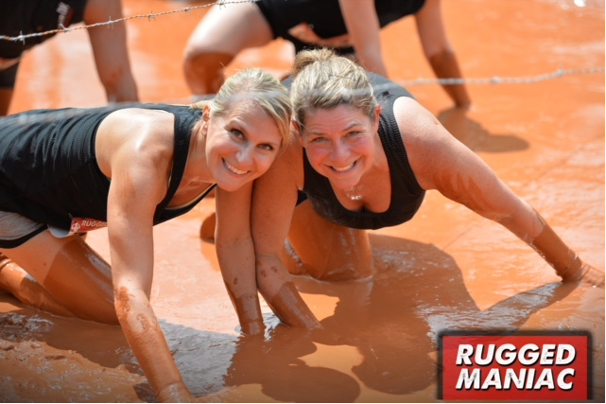
Terri Goldman
Christa Vogt ^{3rd, 4th and 5th}
K ,1st, 2nd, 4th, 5th
We are excited to get to know your children!

Slide 3

Eligibility Reports
Please sign all copies of your child’s eligibility report
Place both copies back in the folder
Results are valid for all of Georgia
No renewal or continuation of testing for eligibility

Slide 4

Mental Ability Test
CogAt-96th percentile or higher in any one of the three tested areas; Verbal, Quantitative, Nonverbal
Naglieri-Nonverbal test for students who have previously taken the CogAt-96th percentile or higher qualifying score

Slide 5

Achievement
Grades K-2-Stanford 10 Test-90th percentile in one area
Grades 3-5- Stanford 10Test-90th percentile in Total Reading, Math or Composite

Slide 6

Creativity
Torrance Test of Creative Thinking-Standardized test of creativity.
90th percentile or higher qualifying score
Product Assessment-Given in regular classroom-scored by product scoring team
90th percentile or higher qualifying score

Slide 7

Motivation
All teachers rate students
Highest score is taken
90th percentile or higher qualifying score

Slide 8
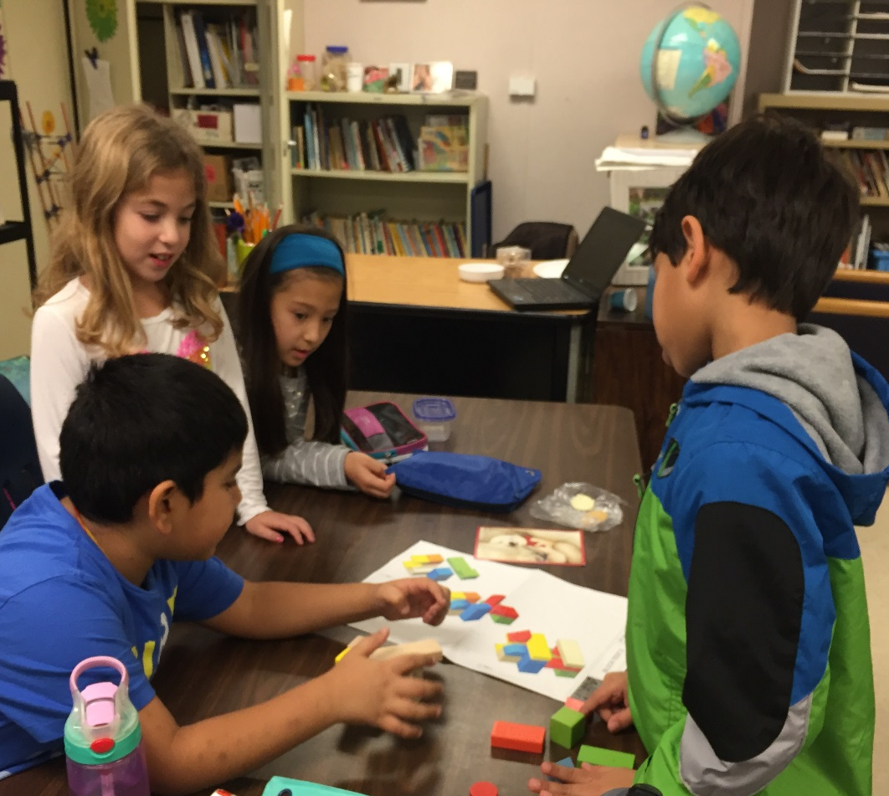
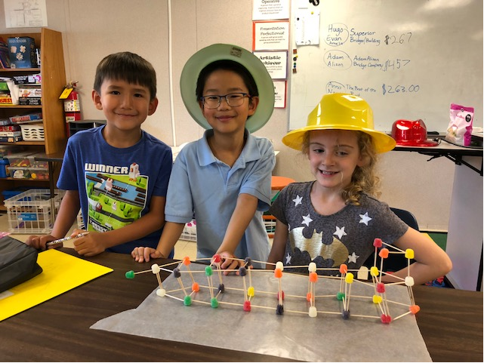
TAG IS…A Program That Addresses Both Academic Goals, and Social/Emotional Goals
TAG helps students understand their abilities, and their potential for contributions to society.
TAG fosters both independent learning and interaction, and cooperation with students of both similar and different abilities.
TAG provides opportunities for gifted students to discover and explore new interests and aptitudes.

Slide 9


TAG Program Overview
The TAG Program is a Resource Program.
We meet with each grade level class once a week for the entire day.
Students have lunch and specials with their regular class.
.

Slide 10
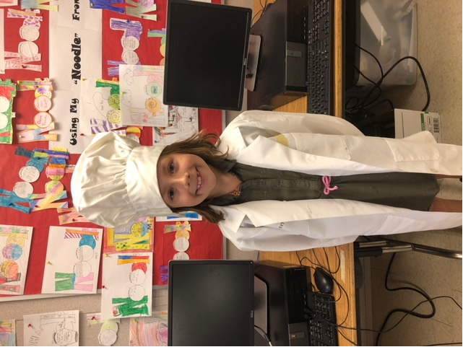
TAG Curriculum
Three Units of Study Each Year
Higher Order Critical Thinking Skills (HOCT)
Creative Thinking & Problem Solving (CPS)
Advanced Research
**Advanced Technology and Communication Skills Will Be Part of Each Unit Of Study
Notes:
Discuss research units as an example of how students progress on standards throughout the years.

Slide 11
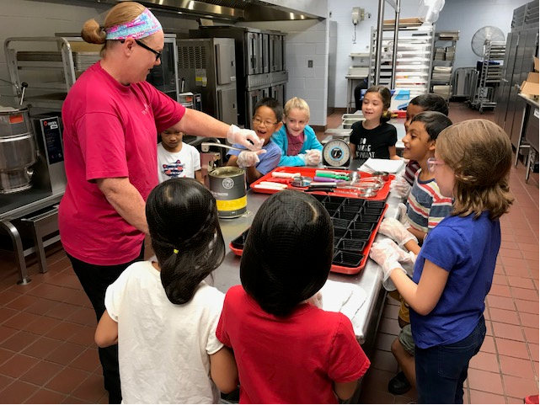
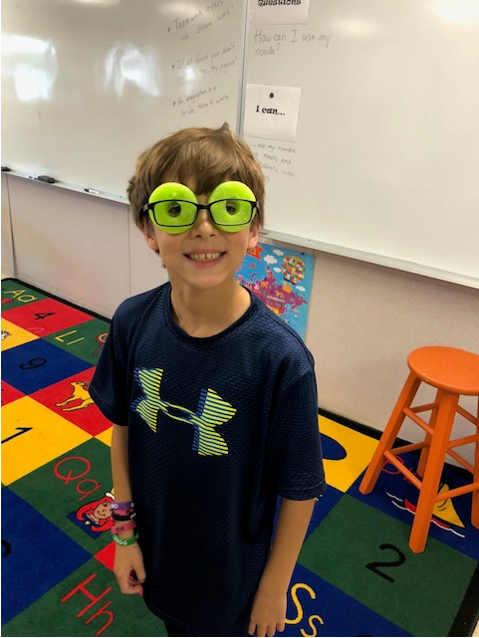
TAG Units of Study
Tentative Unit Timetable:
Unit 1-August-November
Unit 2-December-February
Unit 3-February-May
Breaking for testing 9/24-10/5

Slide 12
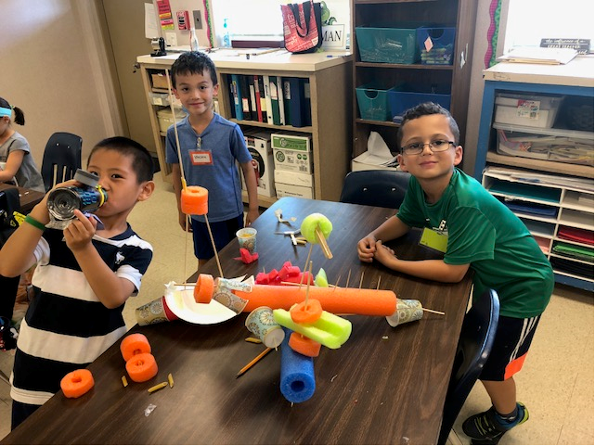
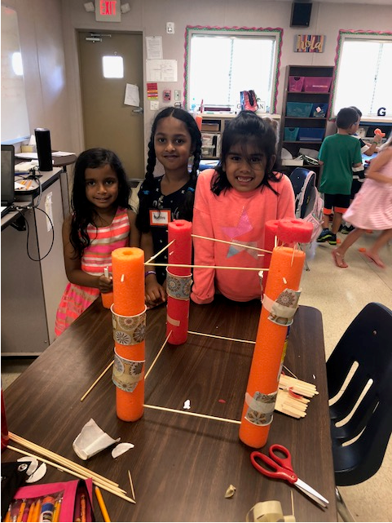
Kindergarten, First & Second
Grade Units
d
Architecture
Nature’s Myths
Where in the World?
Notes:
Units are subject to change

Slide 13
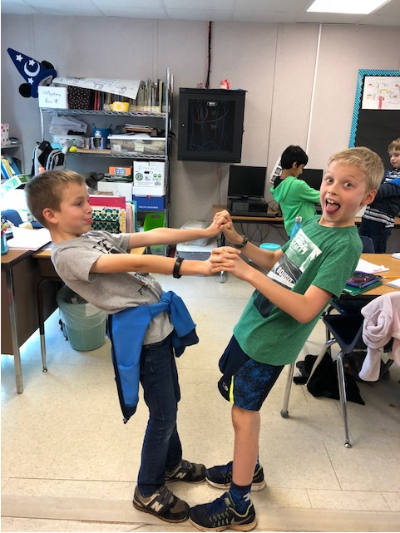
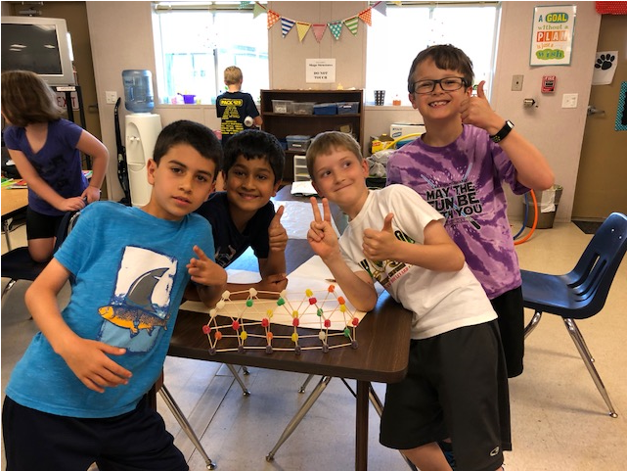
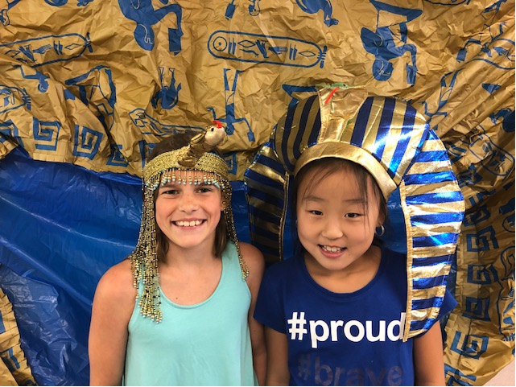
Third Grade Units
Biomes of the World
Freedom Express
Ancient Civilizations
Notes:
Give examples of highlights of units. Biomes-owl pellet dissection, research, power point presentations.

Slide 14
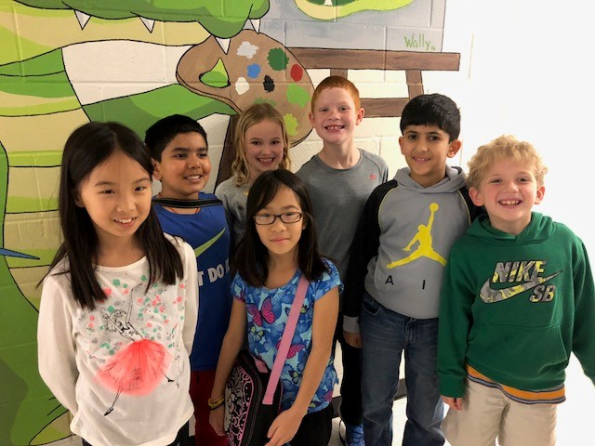
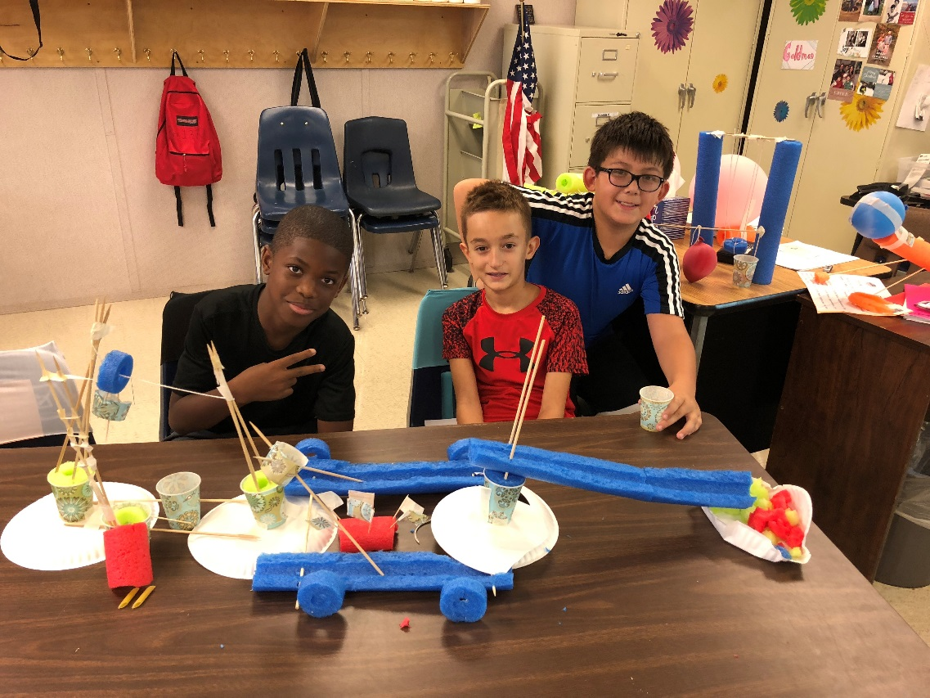
Fourth Grade Units
Space Exploration
Camp Interdependence
Amusement Park
Notes:
CI-National Park research, make brochure for park.

Slide 15
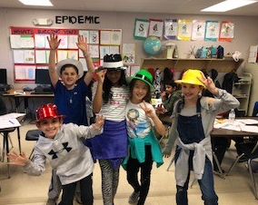
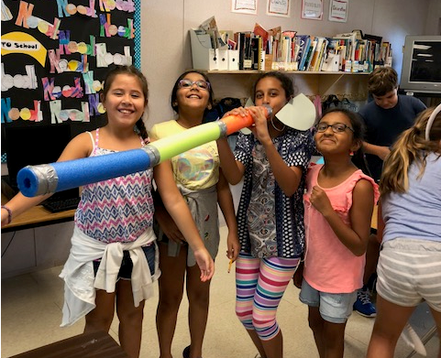
Fifth Grade
Units
Be the Change
Epidemic
Salt Life

Slide 16
Supplies Needed
All TAG students should bring a healthy nut free snack.
water bottles are welcome.
The Students will also need
a 2- pocket folder and spiral notebook. The spiral notebook may be any color, but the folders should be :
Monday- Green
Tuesday- Yellow
Wednesday- Blue
Thursday -Red
Friday- Orange

Slide 17

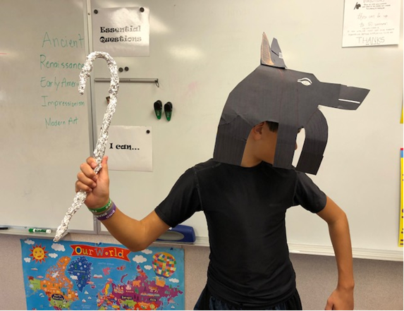
R
E
P
O
R
T
C
A
R
D
S
TAG Report Cards will be sent home at the end of each unit.
Students are given a Satisfactory (S), Progressing, (P) or Needs Improvement (N) grade for all academic and behavioral areas covered in class

Slide 18
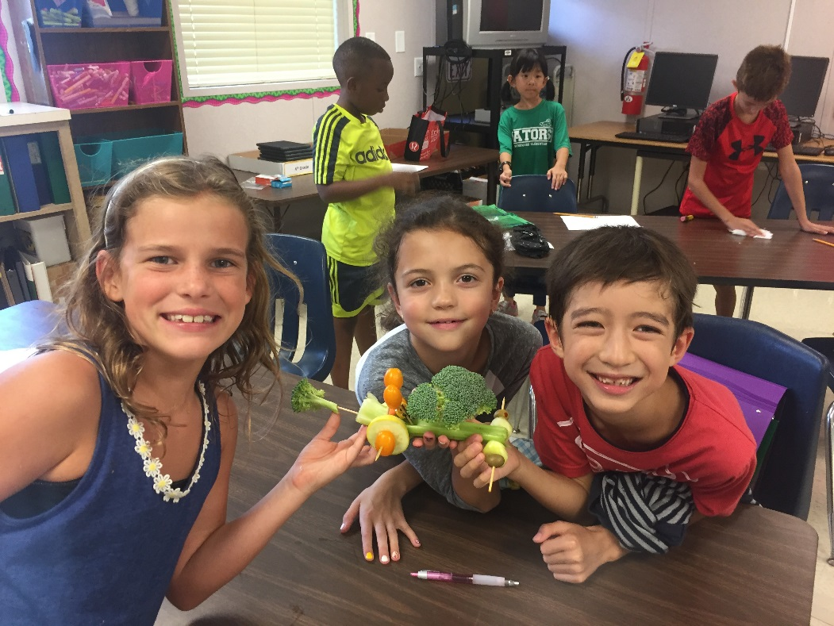
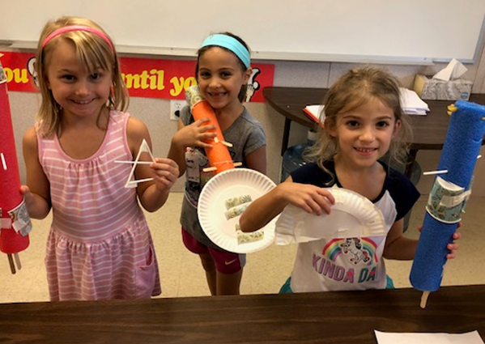
Tag Conferences
TAG conferences will be scheduled at parent request.
Parents will be notified if there are serious academic/behavioral issues and an action plan will be enacted.

Slide 19

Questions?
Thank you for Coming!!!
Any Questions???
The best way to contact us is through our Fulton County E-Mail
goldman@fultonschools.org
vogt@fultonschools.org
taglwe.weebly.com

